Slide 1
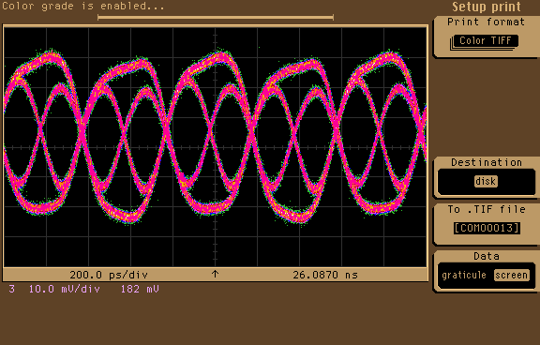
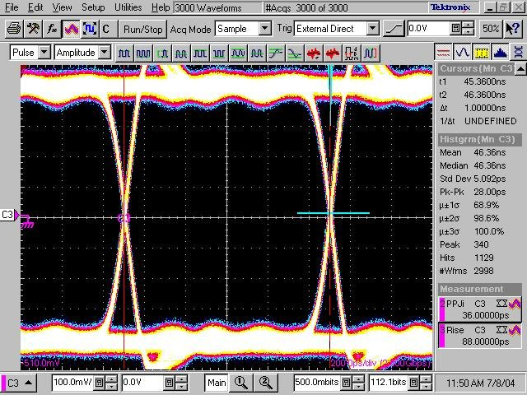
Welcome to
Digital Systems Testing
ECE 6140

Slide 2
ECE 6140 - Instructor Information
Dr. David Keezer
Office: Klaus Adv Comp Bldg 1360 (Lab is 1361)
Phone: 404-894-4741
E-Mail: dkeezer@ece.gatech.edu
Office Hours: Tue, Thur, 11:10-12:30
in KACB 1360, and by appointment

Slide 3
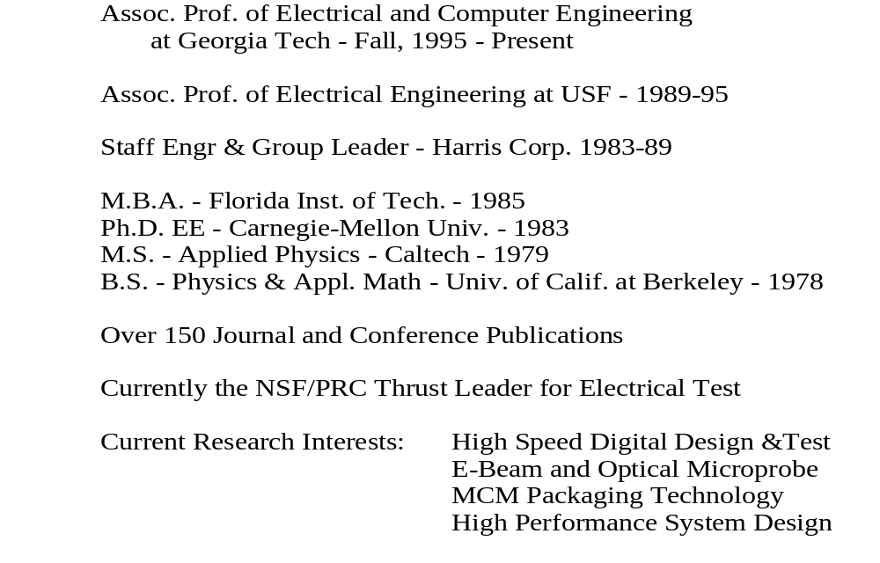
Instructor - David Keezer

Slide 4
ECE 6140 -Text
Digital Systems Testing and Testable Design
By Abramovici, et al
Friedman Computer Science Press,
ISBN #0-7167-8179-4

Slide 5
ECE 6140 - Grading
Midterm Exams 1ab 25+25% (Sept.25, Nov.8)
Project 20% (Dec. 6)
Final Exam 30% (Dec.13, 8:00-10:50PM)
Homework 0% (Assigned, but not graded)

Slide 6
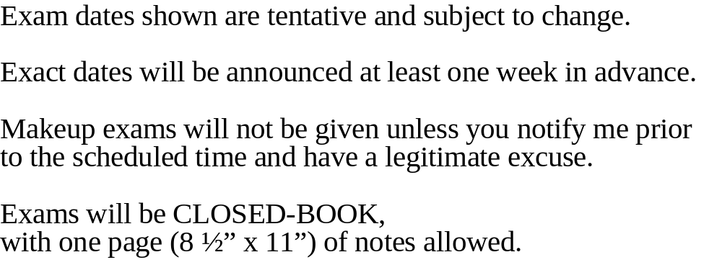
ECE 6140 - Exams

Slide 7

ECE 6140 - Homework

Slide 8
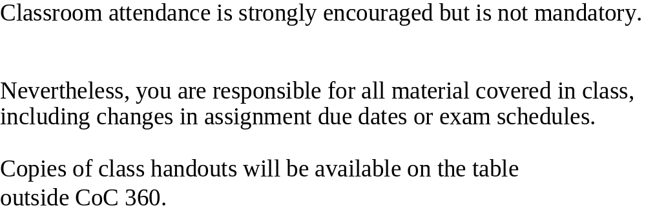
ECE 6140 - Attendance

Slide 9
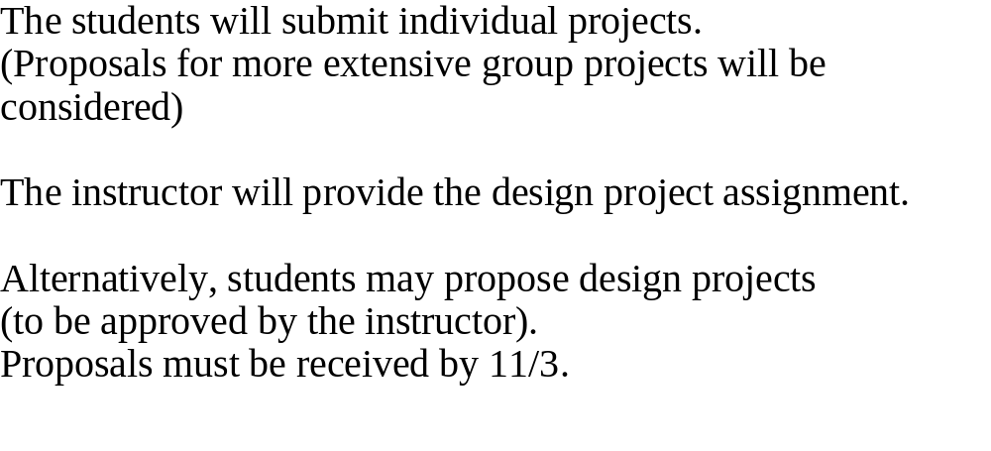
ECE 6140 - Design Project

Slide 10
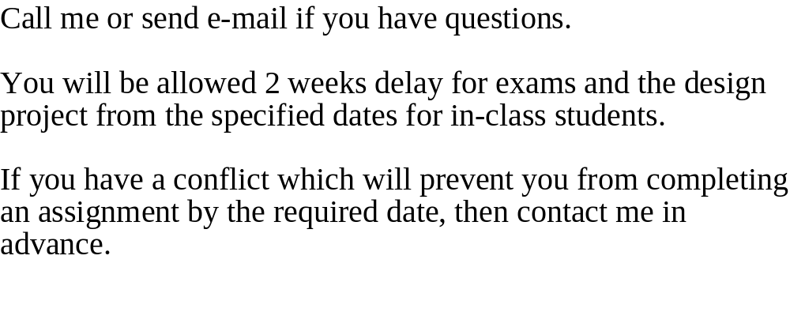
ECE 6140 - Video Students

Slide 11
ECE 6140 – Schedule – Part 1
Week Topics Covered Textbook Reference
8/21 Introduction
Basic Concepts Ch.1
8/28 Fault Modeling Ch.4 (see also, Ch.2 and Ch.3)
9/4 Fault Modeling Ch.4 (see also, Ch.2 and Ch.3)
9/11 Fault Simulation Ch.5
9/18 Fault Simulation Ch.5
9/25 Midterm Exam #1 Ch.1, Ch.4, Ch.5

Slide 12
ECE 6140 – Schedule – Part 2
Week Topics Covered Textbook Reference
9/27 Automatic Test Pattern Generation Ch.6
10/2 Automatic Test Pattern Generation Ch.6
10/9 Automatic Test Pattern Generation Ch.6
10/16 Mid-semester break (NO CLASS!)
10/18 ATPG, HW See handouts
10/23 Design for Testability
& Boundary Scan Ch.9
10/30 Design for Testability Ch 9
11/1 & Boundary Scan

Slide 13
ECE 6140 – Schedule – Part 3
Week Topics Covered Textbook Reference
11/6 HW Review
11/8 * EXAM #2 Ch.6,9
11/13 Compression Techniques & BIST Ch.10
11/15 Compression Techniques & BIST Ch.10
11/20 Short class Built-in Self-test (BIST) Ch.11
11/22 Thanksgiving Holiday
happy holidays!
11/27 Built-in Self-test (BIST) Ch.11
12/1 Built-in Self-test (BIST) Ch.11
12/4 Adv Test Methods see handouts
12/6 Adv Test Methods, Projects DUE
12/13* FINAL EXAM – 8:00am - 10:55am Ch.1,4,5,6,9,10,11

Slide 14
Assignment for Wednesday
READ Chapter 1
Testing and Diagnosis
Levels of Abstraction
Errors and Faults
Modeling and Simulation
Test Evaluation
Types of Testing
Diagnosis and Repair
Test Generation
Design for Testability

Slide 15
Introduction
Testing and Diagnosis
Levels of Abstraction
Errors and Faults
Modeling and Simulation
Test Evaluation
Types of Testing
Diagnosis and Repair
Test Generation
Design for Testability

Slide 16
Testing and Diagnosis
System Testing
  Experiment where the “system” is exercised and its response is analyzed.
Diagnosis
  To locate the cause for misbehavior
Broad applicability of these terms
  Medical tests and “diagnosis”
  “Test-driving” a car
  “Debugging” a computer program

Slide 17
Testing at Different Levels of Abstraction
Digital “systems” have data interacting with control
Level of Abstraction Control Data
  Logic Level Logic values
  Register Level Logic values Words
  Instruction Set Instructions Words
  Processor Level Programs Data Struct.
  System Level Messages

Slide 18
Testing at Different Levels of Abstraction
Test Stimulus/Response corresponds to the type of information processed by the system
This implies that there many types of tests:
  Subsystem tests another by message passing
  Processor does a self test using a diagnostic program
  An ATE tests a circuit by applying/observing sets of logic values (1’s and 0’s)

Slide 19
Testing at Different Levels of Abstraction
Parametric Tests measure electrical characteristics such as threshold voltages, leakage currents, min/max output voltages
  NOT considered in this course

Slide 20
Errors and Faults
(Observed) Error: Incorrect operation of the system under test
Causes of observed errors:
  Design Errors, i.e.
    Bad Specs
    Bad translation between design levels
    Design rule violations
  Fabrication Errors
  Fabrication Defects
  Physical Failures

Slide 21
Errors and Faults
Causes of observed errors:
  Fabrication Errors
    Wrong components
    Wiring errors
    Shorts or opens on electrical interconnections
  Fabrication Defects
    Result from imperfect processing
    e.g. microscopic shorts/opens in Ics,
    wrong doping profiles,
    mask alignment errors

Slide 22
Errors and Faults
Causes of observed errors:
  Physical Failures
    Occur during the system lifetime
    due to component wear-out
    e.g. electrical opens due to electromigration,
    Environmental effects, such as radiation, thermal or mechanical shock, etc.

Slide 23
Errors and Faults
Physical Faults
  include Fab errors and defects, and physical failures
  classified as: permanent, intermittent, transient
  NOT easy to treat mathematically
    Therefore, we deal with Logical Faults
Fault Detection: an error is observed which is caused by the fault
We use Fault Models to idealize and simplify our understanding of potential faults, e.g. the Single Stuck-at (SSA) model

Slide 24
Modeling and Simulation
Design Verification Testing
  A computer is used to “model” the system’s data structures and programs
  The model is stimulated with input signals
  Also called logic, design verification, or true-value simulation
  See also Chapters 2 and 3

Slide 25
Test Evaluation
Test Evaluation:
  Determine the test’s effectiveness or quality
Usually we need a Fault Model
  to bound the number of faults considered
Fault Coverage is ratio of detected faults to the total number of faults permitted by the fault model
Fault Simulation is used to determine if a given test will detect a given fault
  By evaluating all potential faults permitted by the fault model, we can calculate fault coverage

Slide 26
Types of Testing
Criteria for classifying test methods:
  When the test is performed
    Concurrent vs. Seperately
    On-line vs. Off-line
  By stimulus source
    The system vs. and external tester
    Self-test vs. External-test
  What errors are being tested for?
    Design errors, fab errors, fab defects, infant mortality, physical failures
    Design verification test, Acceptance test, Burn-in, quality assurance test, field test, maintenance test

Slide 27
Types of Testing
Criteria for classifying test methods:
  What is being tested
    IC, Board, System
    Component-, Board-, System-Level Tests
  By the speed of the test
    Very Slowly vs. at normal operating speeds
    DC (static), AC, At-Speed Tests
  See other examples in the Text

Slide 28
Types of Testing
Specific examples of test methods:
  Diagnostic Programs
    Off-line, At-Speed, System-Level, Self-Test
  In-Circuit Emulation
    uP is replaced by known-good circuitry
    External, System-Level, Diagnostic Test
  On-Line Testing
    An invariant property of the system response is checked during normal operation (e.g. Parity)
    On-line, Self-test, at-speed

Slide 29
Types of Testing
Specific examples of test methods:
  Guided Probe Testing
    Board-level, interactive diagnostic, system-level test
    Intelligent software guides an operator as to where to probe within the system in order to trace the cause of a detected error
  In-Circuit Testing
    External tester applies patterns to ICs that are assembled into the system
    External, Diagnostic Test
  Golden Unit or Comparison Testing
    The response of the UUT is compared with that of a known-good unit

Slide 30
Diagnosis and Repair
When repair is an option, the cause of an observed error must first be diagnosed
Approach A: Cause-Effect Analysis
  Use fault simulation to build a fault dictionary
  During testing, the UUT response is compared with stored error-responses in the fault dictionary
Approach B: Effect-Cause Analysis
  The UUT response is analyzed to determine the fault(s) that could cause the observed error.
  e.g. guided probe

Slide 31
Test Generation
Test Generation (TG)
  The process of determining the stimuli needed for system testing
Depends on the testing method
  e.g. On-line tests do not require TG,
  Pseudo-Random Pattern tests require very little other than initialization
  Design Verification and Diagnostic tests generally require a lot of manual effort for TG
  ATG is Automated TG

Slide 32
Design for Testability
DFT is the process of incorporating logical features specifically to aid the testing process
The motivation for DFT is principally to reduce the cost of test which can be as much as 40% to 50% of the total product cost
  Part of this cost is amortized ATE cost, which can be 4,5, or even 6 orders of magnitude larger than the UUT
Ultimately, a completely self-testable UUT could almost eliminate test cost
  Must be balanced against the cost of adding BIST

